Slide 1
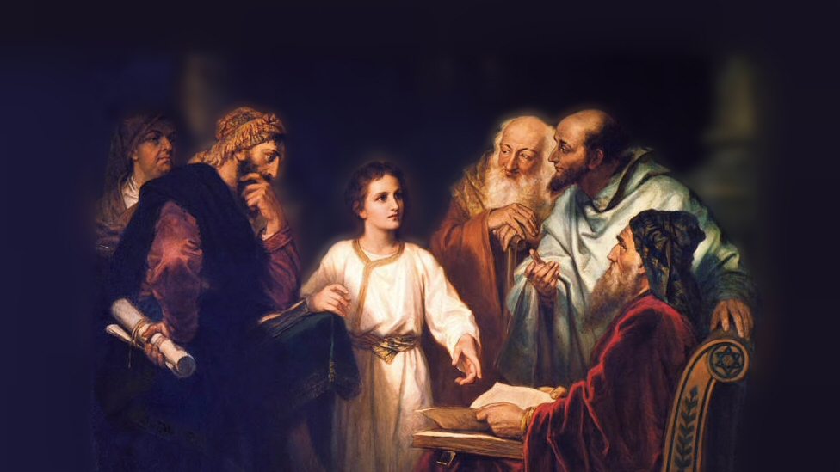
About My Father’s Business
Healing an Afflicted Woman
(Luke 8:43-48)
Notes:
Context: (Also Matthew 9 and Mark 5)
Jesus was asked to heal the daughter of Jairus (a ruler of the synagogue near Capernaum). This miracle happened on the way, as Jesus went to heal the little girl.
(Luke 8:43-48) READ
The woman’s illness led her to desperate action
She was in a crowd, even though her illness made her unclean by the Law
(Leviticus 15:25), “If a woman has a discharge of blood for many days, other than at the time of her customary impurity, or if it runs beyond her usual time of impurity, all the days of her unclean discharge shall be as the days of her customary impurity. She shall be unclean.”
Perhaps we can be understanding of both her courage to touch the border of Jesus’ garment, and her desire to not be discovered
There is reason to fear the great power of God! (Had she displeased the Lord?)
(Matthew 10:28), “And do not fear those who kill the body but cannot kill the soul. But rather fear Him who is able to destroy both soul and body in hell.”
What are some lessons we can learn from observing this miracle?
Picture attribution: More Good Foundation (cropped, with background blurred) Creative Commons Liscense
https://www.flickr.com/photos/moregoodfoundation/5135438113

Slide 2
The Healing of an Afflicted Woman
The Miracle (43-44)
Mark 16:17-18; Hebrews 2:3-4; John 20:30-31
Notes:
(43-44), “Now a woman, having a flow of blood for twelve years, who had spent all her livelihood on physicians and could not be healed by any, ⁴⁴ came from behind and touched the border of His garment. And immediately her flow of blood stopped.”
Instantaneous, and complete (a far cry from claims made today by “faith healers”)
Note: No one has the ability to perform miracles today
This ability belongs to God, or to those who God chooses to impart it to.
(Mark 16:17-18), [Jesus gave that power to His disciples, as signs], “And these signs will follow those who believe: In My name they will cast out demons; they will speak with new tongues; ¹⁸ they will take up serpents; and if they drink anything deadly, it will by no means hurt them; they will lay hands on the sick, and they will recover.”
The purpose of the signs, to confirm the gospel, was accomplished and they are finished
(Hebrews 2:3-4), “How shall we escape if we neglect so great a salvation, which at the first began to be spoken by the Lord, and was confirmed to us by those who heard Him, ⁴ God also bearing witness both with signs and wonders, with various miracles, and gifts of the Holy Spirit, according to His own will?”
(John 20:30-31), “And truly Jesus did many other signs in the presence of His disciples, which are not written in this book; ³¹ but these are written that you may believe that Jesus is the Christ, the Son of God, and that believing you may have life in His name.”

Slide 3
The Healing of an Afflicted Woman
The Miracle (43-44)
Mark 16:17-18; Hebrews 2:3-4; John 20:30-31
The Impotence of Men (43)
Hebrews 9:27-28; James 5:14-15
Notes:
(43), “Now a woman, having a flow of blood for twelve years, who had spent all her livelihood on physicians and could not be healed by any.”
As advanced as medicine is today, we are unable to heal everyone.
Death is the end of all men, and that will never be overcome.
(Hebrews 9:27-28), “And as it is appointed for men to die once, but after this the judgment, ²⁸ so Christ was offered once to bear the sins of many. To those who eagerly wait for Him He will appear a second time, apart from sin, for salvation.”
Prayer remains effective in activating the providence of God to heal. What men can not do, God can, if He will.
(James 5:14-15), “Is anyone among you sick? Let him call for the elders of the church, and let them pray over him, anointing him with oil in the name of the Lord. ¹⁵ And the prayer of faith will save the sick, and the Lord will raise him up. And if he has committed sins, he will be forgiven.”

Slide 4
The Healing of an Afflicted Woman
The Miracle (43-44)
Mark 16:17-18; Hebrews 2:3-4; John 20:30-31
The Impotence of Men (43)
Hebrews 9:27-28; James 5:14-15
The Words of Jesus (45-48)
Mark 2:9-11; 2 Corinthians 8:9
Notes:
(45-48), “And Jesus said, ‘Who touched Me?’ When all denied it, Peter and those with him said, ‘Master, the multitudes throng and press You, and You say, “Who touched Me?”’ ⁴⁶ But Jesus said, ‘Somebody touched Me, for I perceived power going out from Me’ ⁴⁷ Now when the woman saw that she was not hidden, she came trembling; and falling down before Him, she declared to Him in the presence of all the people the reason she had touched Him and how she was healed immediately. ⁴⁸ And He said to her, ‘Daughter, be of good cheer; your faith has made you well. Go in peace.’”
Jesus was not unaware, he was drawing attention to the woman, and what she did
Jesus did not have His power depleted, (it is infinite). However, it does indicate something about the nature of miracles. They are accomplished by the transfer of Divine POWER.
That same power gave Jesus the ability to forgive sins!
(Mark 2:9-11), “Which is easier, to say to the paralytic, ‘Your sins are forgiven you,’ or to say, ‘Arise, take up your bed and walk’? ¹⁰ But that you may know that the Son of Man has power on earth to forgive sins”—He said to the paralytic, ¹¹ “I say to you, arise, take up your bed, and go to your house.”
Jesus’ words showed great compassion toward the woman
“Be of good cheer”… “Go in peace”
(2 Corinthians 8:9), [This compassion is seen in its greatest measure in His selfless sacrifice for us], “For you know the grace of our Lord Jesus Christ, that though He was rich, yet for your sakes He became poor, that you through His poverty might become rich.”

Slide 5
The Healing of an Afflicted Woman
The Miracle (43-44)
Mark 16:17-18; Hebrews 2:3-4; John 20:30-31
The Impotence of Men (43)
Hebrews 9:27-28; James 5:14-15
The Words of Jesus (45-48)
Mark 2:9-11; 2 Corinthians 8:9
The Power of Faith (48)
Matthew 17:19-20; Hebrews 11:6
Notes:
(48), “And He said to her, ‘Daughter, be of good cheer; your faith has made you well. Go in peace.’”
Faith makes all things possible
(Matthew 17:19-20), [Unlike His disciples, Jesus was able to cast out a demon from an afflicted child], “Then the disciples came to Jesus privately and said, “Why could we not cast it out?” ²⁰ So Jesus said to them, “Because of your unbelief; for assuredly, I say to you, if you have faith as a mustard seed, you will say to this mountain, ‘Move from here to there,’ and it will move; and nothing will be impossible for you.”
What do we mean when we say that all things are possible?
Does not indicate we can expect a miracle because we believe, if it is not God’s will. However, that is exactly what happened in our text!
All things that GOD desires for us! Ultimately and most importantly, that means we can have salvation through faith!
(Hebrews 11:6), “But without faith it is impossible to please Him, for he who comes to God must believe that He is, and that He is a rewarder of those who diligently seek Him.”

Slide 6
Conclusion
Do you have the same faith as that of this woman? If you do, then you can receive the blessings of God!
Ephesians 3:17-19
Notes:
(Ephesians 3:17-19), [Paul’s prayer on behalf of the Ephesians], “That Christ may dwell in your hearts through faith; that you, being rooted and grounded in love, ¹⁸ may be able to comprehend with all the saints what is the width and length and depth and height— ¹⁹ to know the love of Christ which passes knowledge; that you may be filled with all the fullness of God.”

